Slide 1
Marketing Analytics
Sameer Prajapati

Slide 2
Business Problem
ShopEasy, an online retail business, is facing reduced customer engagement and conversion rates despite launching several new online marketing campaigns. They are reaching out to you to help conduct a detailed analysis and identify areas for improvement in their marketing strategies.
Key Points:
Reduced Customer Engagement: The number of customer interactions and engagement with the site and marketing content has declined.
Decreased Conversion Rates: Fewer site visitors are converting into paying customers.
High Marketing Expenses: Significant investments in marketing campaigns are not yielding expected returns.
Need for Customer Feedback Analysis: Understanding customer opinions about products and services is crucial for improving engagement and conversions.

Slide 3
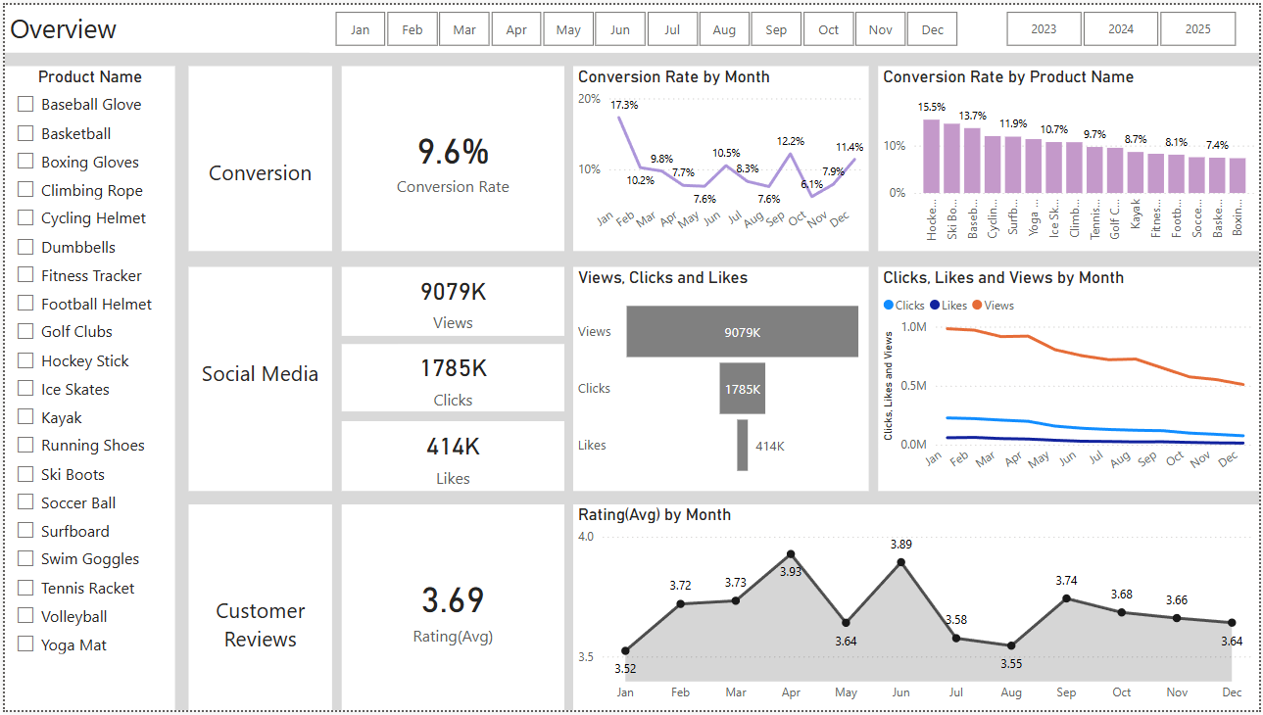
Overview
Key Observations:
Combines Conversion (9.6%), Social Media (9079K Views), and Customer Reviews (3.69).
Conversion by Product: Hockey Stick leads (15.5%); Boxing Gloves last (7.3%).
Engagement Drop:
Views: Constantly declining across months.
Clicks and Likes follow a similar trend.
Rating by Month: Peak in May (3.93), dips in July (3.55) and Sept (3.64).

Slide 4
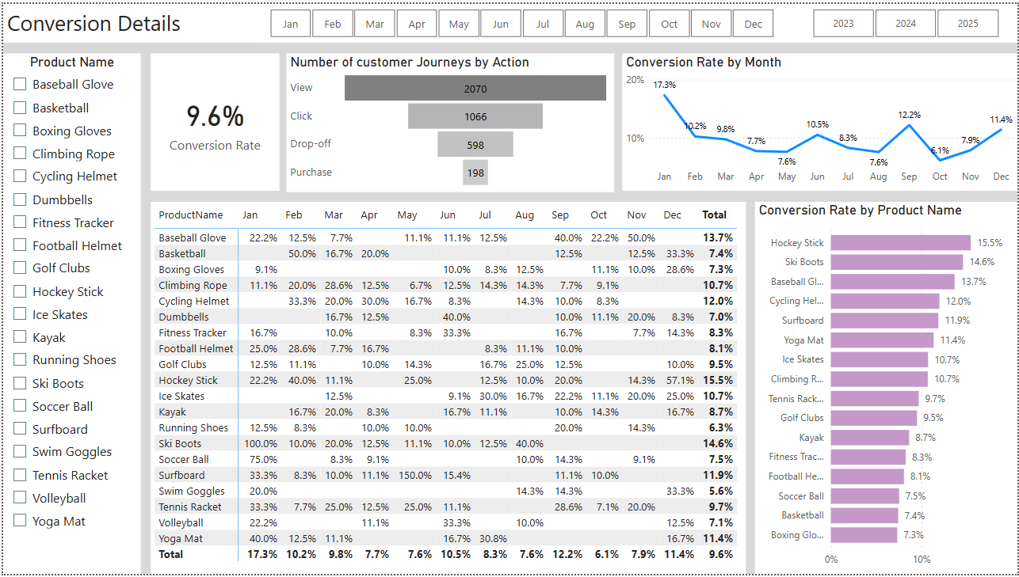
Conversion Rate
Problems:
Huge drop-off between Clicks and Purchases.
Several popular products (Basketball, Soccer Ball) have low conversion.
Inconsistent month-wise performance with long low-conversion periods (Apr to Oct).
Solutions:
Optimize checkout process to reduce drop-offs (simplify steps, better mobile UX).
Run remarketing campaigns for drop-offs.
Improve product pages for low-converting but high-engagement items (e.g., Basketball).
Create monthly campaigns to boost seasonal conversion (e.g., Ski Boots in winter).

Slide 5
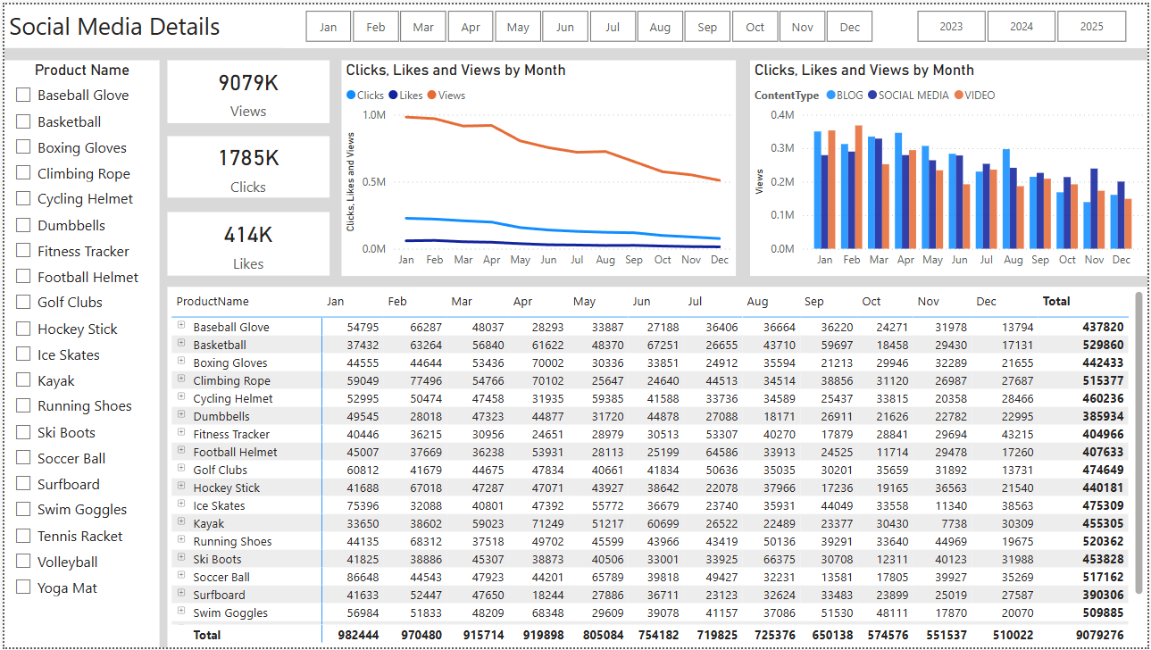
Social Media
Key Observations:
Total Views: 9M+, Clicks: 1.78M, Likes: 414K.
Views by Content Type: Videos lead, followed by Social Media and Blogs.
Engagement by Product:
Highest: Basketball (529K), Running Shoes (520K)
Lowest: Dumbbells, Football Helmet
Monthly Trend:
All metrics (views, clicks, likes) show a steady downward trend.
Problems:
High views but low conversions from social media.
Steady decline in performance over months.
Low-performing products still being promoted.
Solutions:
Invest in high-performing content types (short videos).
Use influencers or user-generated content for products like Running Shoes & Swim Goggles.
Pause promotion on underperformers and reallocate budget.

Slide 6
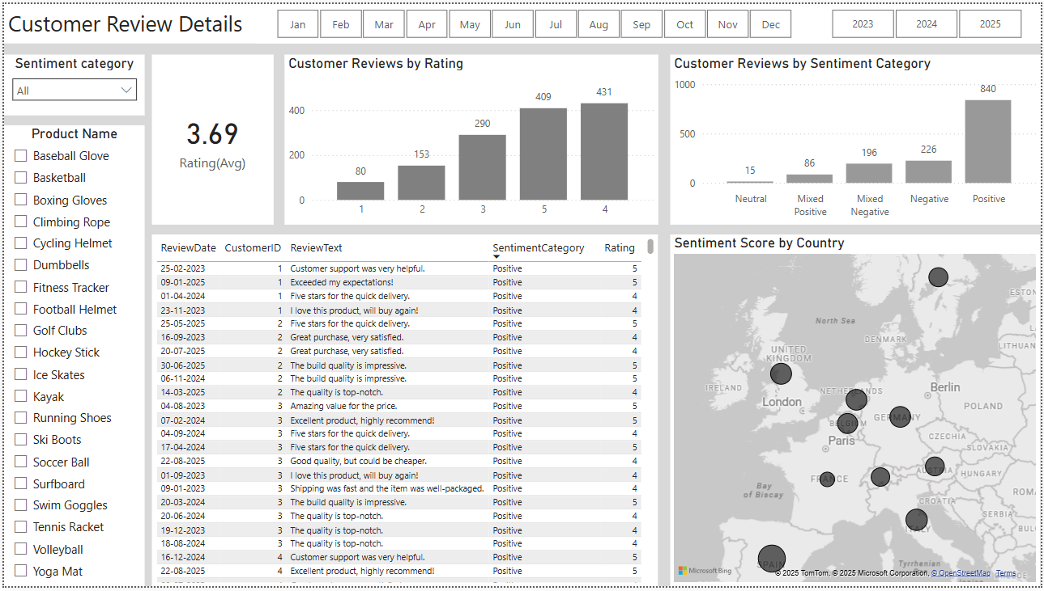
Customer Review
Problems:
Nearly 23% of feedback is negative or mixed.
Average rating below ideal 4.0 benchmark.
No product-wise rating split available here (missing granularity).
Solutions:
Respond to negative reviews to resolve issues and improve customer satisfaction.
Reward high-rating reviewers with loyalty points.
Use review text analysis to identify product flaws and improve quality.

Slide 7
Goals & Actions
Actions for Conversion Goals
Redesign product and checkout pages for clarity and speed.
Implement abandoned cart recovery (email/SMS reminders).
Use targeted retargeting ads for products with high drop-off.
Actions for Review Goals
Encourage reviews via post-purchase emails and loyalty rewards.
Regularly analyze feedback text to identify product improvement areas.
Promote top-rated reviews on product and landing pages.
Actions for Social Media Goals
Prioritize high-engagement content types like short-form videos.
Run influencer partnerships for trending or high-visibility products.
Use carousel posts and Reels on Instagram, Shorts on YouTube.
Increase overall conversion rate from 9.6% to 12%.
Improve conversion rates of low-performing products (e.g., Basketball, Soccer Ball).
Reduce drop-off rate between clicks and purchases.
Improve average customer rating from 3.69 to 4.2+.
Reduce percentage of negative and mixed reviews (currently 25%+).
Increase positive customer engagement and brand trust.
Increase social media click-through rate from views to clicks.
Reverse the monthly downward trend in views and likes.
Shift budget focus toward high-performing platforms and content types.

